Slide 1
Beneficial Consequences of Open-Source Software
Gives everyone opportunity to improve program
New versions of programs appear more frequently
Eliminates tension between obeying law and helping others
Programs belong to entire community
Shifts focus from manufacturing to service
1-<number>

Slide 2
Examples of Open-Source Software
BIND
Apache
Sendmail
Android operating system for smartphones
Firefox and Chrome
OpenOffice.org
Perl, Python, Ruby, TCL/TK, PHP, Zope
GNU compilers for C, C++, Objective-C, Fortran, Java, and Ada
1-<number>

Slide 3
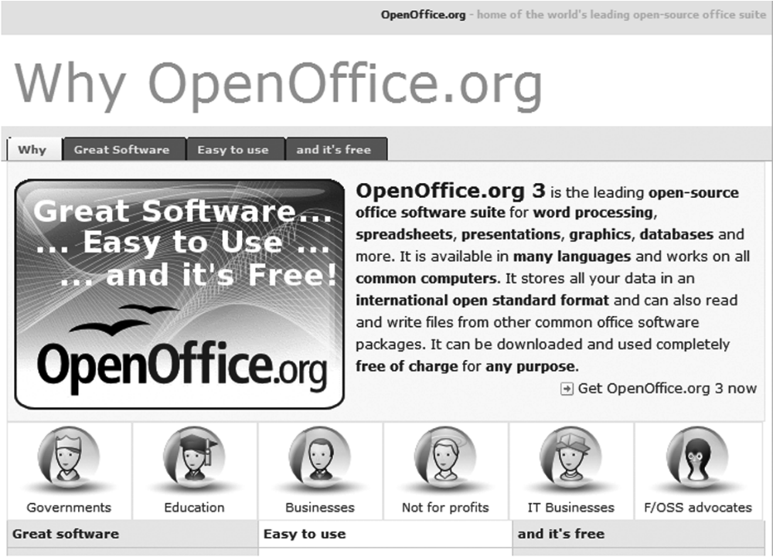
Screenshot from OpenOffice.org, a registered trademark of Apache Software Foundation. Copyright © 2012 by Apache Software Foundation. Reprinted with permission.
1-<number>

Slide 4
GNU Project and Linux
GNU Project
  Begun by Richard Stallman in 1984
  Goal: Develop open-source, Unix-like operating system
  Most components developed in late 1980s
Linux
  Linus Torvalds wrote Unix-like kernel in 1991
  Combined with GNU components to make an O.S.
  Commonly called Linux
1-<number>

Slide 5
Impact of Open-Source Software
Linux an alternative to proprietary versions of Unix
Linux operating system on 95% of the world’s 500 fastest supercomputers
1-<number>

Slide 6
Crititique of the Open-Source Software Movement
Without critical mass of developers, quality can be poor
Without an “owner,” incompatible versions may arise
Relatively weak graphical user interface
Poor mechanism for stimulating innovation (no companies will spend billions on new programs)
1-<number>

Slide 7
4.9 Legitimacy of Intellectual Property Protection for Software
1-<number>

Slide 8
Do We Have the Right System in Place?
Software licenses typically prevent you from making copies of software to sell or give away
Software licenses are legal agreements
Not discussing morality of breaking the law
Discussing whether society should give intellectual property protection to software
1-<number>

Slide 9
Rights-based Analysis
“Just deserts” argument
  Programming is hard work that only a few can do
  Programmers should be rewarded for their labor
  They ought to be able to own their programs
Criticism of “just deserts” argument
  Why does labor imply ownership?
  Can imagine a just society in which all labor went to common good
  Intellectual property not like physical property
1-<number>

Slide 10
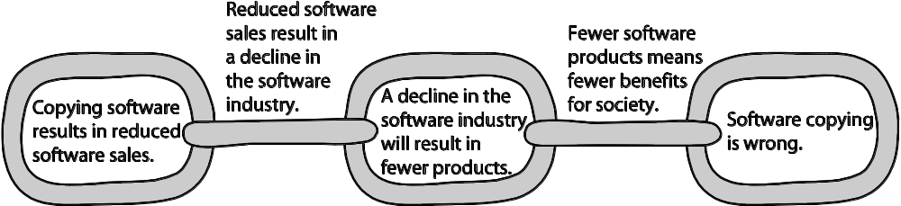
A Consequentialist Argument Why Software Copying Is Bad
Beth Anderson
1-<number>

Slide 11
Utilitarian Analysis
Argument against copying
  Copying software reduces software purchases…
  Leading to less income for software makers…
  Leading to lower production of new software…
  Leading to fewer benefits to society
Each of these claims can be debated
  Not all who get free copies can afford to buy software
  Open-source movement demonstrates many people are willing to donate their software-writing skills
  Hardware industry wants to stimulate software industry
  Difficult to quantify how much society would be harmed if certain software packages not released
1-<number>

Slide 12
Conclusion
Natural rights argument weak
Utilitarian argument not strong, either
Nevertheless, society has granted copyright protection to owners of computer programs
Breaking the law is wrong unless there is a strong overriding moral obligation or consequence
1-<number>

Slide 13
4.10 Creative Commons
1-<number>

Slide 14
Streamlining Creative Re-use
Under current copyright law, eligible works are copyrighted the moment they are created
No copyright notice does not mean it’s okay to copy
Must contact people before using work
That slows down creative re-use
Free Creative Commons license indicates
  Which kinds of copying are okay
  Which rights are being retained
Flickr and Magnatune two well-known sites using Creative Commons licenses
1-<number>

Slide 15
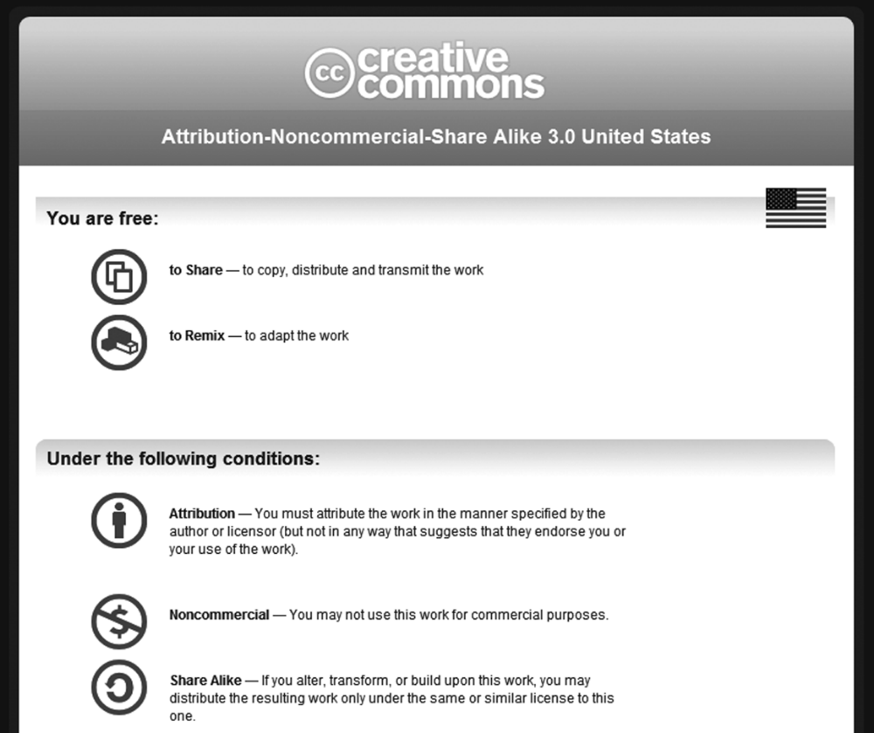
1-<number>
Screenshot from Creative Commons. Copyright © 2011 by Creative Commons. Reprinted with permission.

Slide 16
Chapter 5:
Information
Privacy

Slide 17
Chapter Overview
Introduction
Perspectives on privacy
Information disclosures
Data mining
Examples of consumer backlash
1-<number>

Slide 18
5.1 Introduction
1-<number>

Slide 19
Information Technology Erodes Privacy
Collection, exchange, combination, and distribution of information easier than ever, lessens privacy
Scott McNealy: “You have zero privacy anyway. Get over it.”
We will consider how we leave an “electronic trail” of information behind us and what others can do with this info
1-<number>

Slide 20
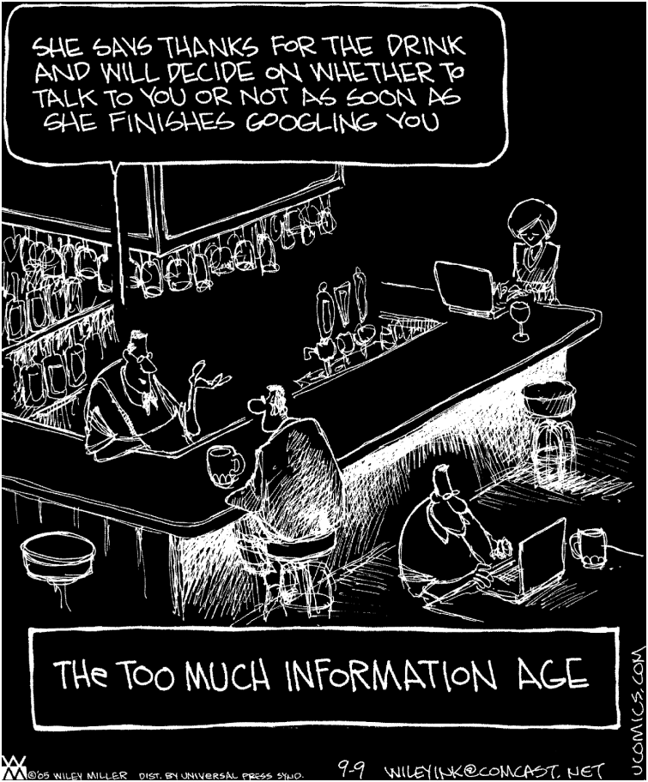
NON SEQUITUR © 2005 Wiley Ink, Inc. Dist. By UNIVERSAL UCLICK. Reprinted with permission. All rights reserved.
1-<number>

Slide 21
5.2 Perspectives on Privacy
1-<number>

Slide 22
Defining Privacy
Privacy related to notion of access
Access
  Physical proximity to a person
  Knowledge about a person
Privacy is a “zone of inaccessibility”
Privacy violations are an affront to human dignity
Too much individual privacy can harm society
Where to draw the line?
1-<number>

